Slide 1
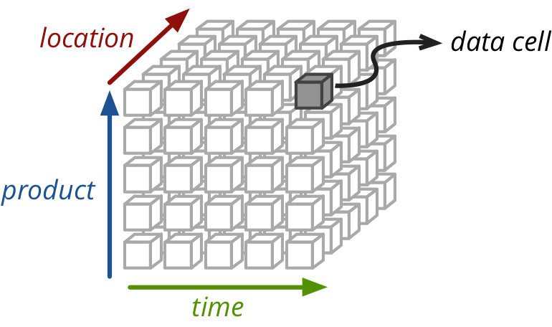
Signal
Features
Dataset
Sample
Force
Magnitude
Force
Location

Slide 2
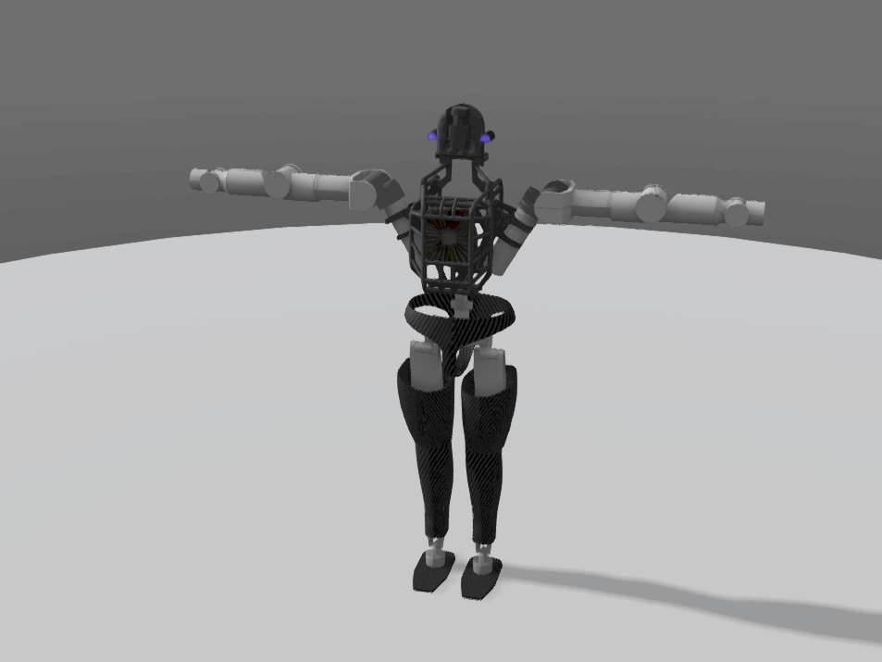
B
A
4
9
6
8
D
5
10
3
1,2
C
7
16,17
12,13
15
11
F
E
18
14

Slide 3
B
A
D
C
F
E

